Slide 1
Executive Overview
January 2015

Slide 2
The Problem
“Our application is ‘slow’, ‘clunky’, and ‘old’”
“Designers are constrained by technology”
“It takes too long for us to build anything”
“Our brand is fragmented across channels”
Sound Familiar???

Slide 3
The Opportunity
Support multiple channels with a single codebase and a single technology stack
Technology that enables strategy and design; Tech is no longer the org who says ‘no’ to everything
Web applications ‘feel’ and behave like native apps
Faster development cycles are possible
What do your stakeholders want?

Slide 4


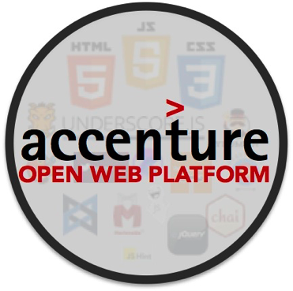



The Solution
Lightweight Architecture
Approach to build scalable, high performance applications quickly, using repeatable processes and the right technology ecosystem.
Responsive Design Evolved
Designing to what the user needs rather than being forced down narrow pathways by limiting, outdated technology.
Modern Web Technology
HTML5/CSS and JavaScript based applications combined with APIs allow for a common UI platform and single app codebase that is both responsive and inherently cross-platform.
DevOps
The intersection of Development, QA, and Operations that focuses on automation, quality, and agility in delivery
Reference Architectures
Reusable assets including Scaffolds and Boiler templates to jumpstart development efforts

Slide 5









New Architecture for New Class of Apps: Client/API
There is a distinct shift from traditional 3-tier Web applications to new Client/API model
Traditional
Client/API
Client
(Browser)
Client
(Browser)
The browser w/ JavaScript, HTML5 & CSS3 has evolved to a high performing, native-like desktop platform.
APIs handle business logic and interaction between the UI and the back end.
Client/API architecture is truly decoupled: modular systems ensure technology and experiences doesn’t become stale.
Page
View
Handlers
Controller
Event Handlers
Local Data
Model
Services
HTML
Data
App Server
APIs
View
API Façade / Gateway
Controller
Security / Execution
Model
Services
Services
HTTP/ WebSockets
Data
Data
Backend
Backend
DB
Systems of Record
DB
Client/API = Single Page Web Applications + APIs

Slide 6

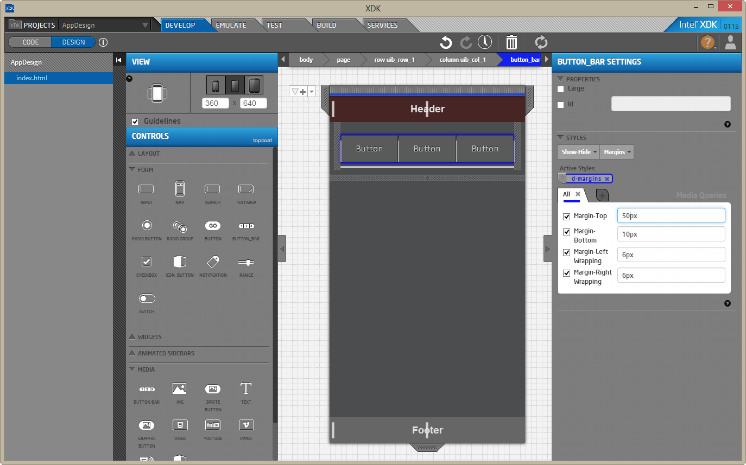


Solution Component - JavaScript-Powered Clients
JavaScript now powers User Interfaces from refrigerators to tablets
JavaScript is the #1 language on GitHub
JavaScript performance continues to improve across the board
When SDKs are created or new cloud services introduced, JavaScript support tends to arrive before any other language
Node.js rose to become the world’s largest open source project in record time
JS Performance Graph
JavaScript powers many device SDKs
JS-Powered Devices

Slide 7














Solution Component - APIs
Easy to use APIs accelerate application development, and enable opportunities to create new types of applications that were previously unattainable.
Reactive APIs
REST
Public APIs
Private APIs
Single Page UI Application
WebSockets
Server-side Events

Slide 8

Client/API Architecture – Web Client / Hybrid Mobile
A modern cross-platform architecture can decouple itself from the server completely, and only rely on data from the server via an API
Web Server
App (iOS / Android)
UIWebView (Browser)
CMS
Client-side MV*
Back End Systems of Record
REST, etc
API Layer
UI Library
DOM Helper
Security Authorization, Validation, and Enforcement
Templates
Other Helpers
Enterprise Services
Phonegap
Same code, multiple deployment paths
Native OS

Slide 9
Client/API Architecture – Client + Presentation APIs
A modern cross-platform architecture can also utilize a lightweight Web API layer (often written in node.js) to handle complex tasks on the server side
Presentation API Layer
CMS
Web Server
Templates
Browser
Orchestration
UI-Specific Endpoints
Client-side MV*
Back End Systems of Record
REST, etc
Execution Services
API Layer
Security Authorization, Validation, and Enforcement
Content Services
UI Library
DOM Helper
Enterprise Services
etc
Templates
Other Helpers
Response Caching
Load Balancing

Slide 10
Client/API Architecture – Isomorphic JavaScript
JavaScript-based application architecture in which the application runs both on the client and on the server, powered by real-time and reactive APIs
Web Platform
Web Platform
CMS
Browser
Core UI
Intelligent UI Rendering
MV*
MV*
Back End Systems of Record
API Layer
Security Authorization, Validation, and Enforcement
UI Libraries
Helpers
UI Libraries
Helpers
Templates
Routing
Templates
Routing
Enterprise Services
Real time Communication
REST
Reactive APIs
API Facade
WebSockets
Storage

Slide 11







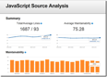









Client/API Architecture - DevOps
Modern Web Architecture requires a journey toward the next generation of agile development methods, DevOps capabilities, and quality-first engineering principles
Jenkins begins automated build & deploy process
mocha
Once code review is approved, git is used to push the code update to development branch
Grunt provides Automated task scripting
Grunt runs automated mocha behavior with chai assertions and unit tests via phantomjs & casperjs
JS Hint runs code quality tests and Plato runs code analyses
Developer cuts feature branch, writes tests, writes code, and submits for review
Check-in merged to Phabricator for pre-commit review by senior developers
Code artifacts, including applications are stored/retrieved in NPM and Bower
Passes Automated QA
Feedback is passed to developers
Code is packaged & readied for deploy by Grunt
QA Testers test on multiple devices
Code is deployed to environments by Jenkins via Docker

Slide 12


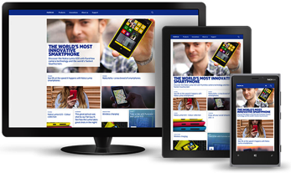

Responsive Design Evolved
What is responsive design?
A Web design and development methodology that helps ensure the user interface delivers an optimal viewing experience on any screen size
Key Components
Grid System
CSS3 Media Queries
Fluid Components
Progressive Enhancement
Why ‘Evolved’?
Responsive design is more than just mobile and desktop, it’s everything
Web technologies have become pervasive UI technologies for televisions, refrigerators, smart devices, and many more
Responsive as a methodology must evolve to support these new form factors without increased complexity or entirely separate applications
Add same UI on
Wearable
TV
Kiosk

Slide 13


Understanding Lightweight Architecture
Lightweight architecture is a set of principles, patterns, and technologies that enable enterprise applications to be delivered with the same capabilities that internet scale startups once had solely to themselves
Lightweight applications are purpose-built and leverage an ecosystem of components
Lightweight architectures are modular and utilize community open source components
Fully distributed systems are standard; components designed to run on commodity hardware
Brings the ability to swap components in and out as technology evolves
A lightweight architecture is not required for Client/API applications, but will enable far superior experiences
Traditional frameworks are built to serve the same function as Swiss Army knives
They don’t do any one thing particularly well
Components need to be extensively modified to fit requirements
Lead to multiple drawbacks: difficulty upgrading, lack of compatibility, etc.
Lead to significantly higher operating cost
Browser
SW LB
SW LB
Service
Service
Store
Store
Behind that application UI running in the browser is often a purpose-built distributed architecture that powers the interactive UI with capabilities not possible in traditional architectures
Disk
Disk

Slide 14
Why these changes?

Slide 15
Why would I make such a radical shift?
Enterprises are evolving toward Client/API approaches rather than continuing to invest in Traditional Web
Baseline experience and performance expectations for end users is now mobile native apps; these expectations cannot be supported by traditional Web architectures
Don’t create new systems every time you need to upgrade; instead create modular systems capable of evolving
Deliver architecture and high quality experience quickly; application development lifecycle should be months, not years
Enable fewer developers, designers, and testers to deliver applications for multiple channels despite budget realities

Slide 16



Technical Challenges
Client/API applications can have SEO challenges if not properly architected
JavaScript/HTML/CSS client performance is increasing rapidly, but quality is a high stakes game
If needed, how do we support legacy browsers, accessibility features, etc?
There are many technical challenges that can derail client/API applications
=
or
Performance depends on architecture choices!

Slide 17













JavaScript is an Ecosystem, not a Framework
JavaScript has a tool and library ecosystem that is unrivalled.
Package Managers
Task Runner
Templating Engines
Reactive Programming
UI Libraries
MV* Frameworks / Libraries
There are community-maintained packages for most app components.
How to choose right components for each project, and ensure they fit architecture?
Which components are right for projects comes down to a litany of requirements: browser support, integration, etc.

Slide 18
What problems remain – Why Accenture?
How do I enable a large work force used to traditional architectures and approaches?
How do I make sure my Architects don’t create last year’s solution with this year’s technology?
How do I bring all of these innovative technologies together without investing significant R&D?
How do I ensure the highest quality delivery despite the newness of the technology and architecture to my organization?
This is where Accenture Open Web Platform can help!

Slide 19
Accenture Open Web Platform

Slide 20














The Accenture Open Web Platform brings together best of breed open source technology, lightweight architecture to enable enterprises to build cross-channel, user-focused applications that transcend the one-page-at-a-time paradigm.
Nex-gen UI Reference Architecture and Applications
AOWP Core Capabilities:
Architect: Creating UI reference architectures for clients
Build: Crafting Web applications using best of breed components, tools, and practices
Deliver: DevOps and automation tools and processes to enable continuous delivery
DevOps, Continuous Delivery, & Automation processes for UI
Using experience distilled from hundreds of projects, we’ve pre-integrated components that fit a variety of application patterns; so delivery can focus on creating experiences and delivering a working application.

Slide 21
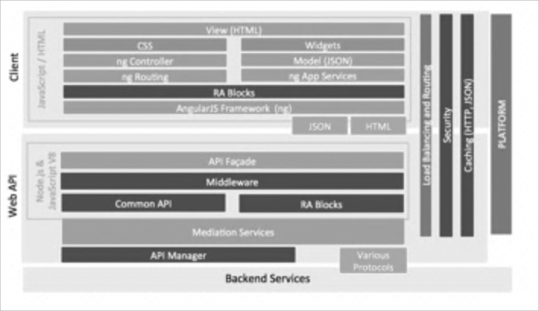









Architect
Model
Route
View
Logger
Widgets
Complete set of reference architectures to guide application development down predictable paths and according to lightweight architecture principles.
Best of breed components for each application style selected trough a rigorous process including performance, suitability for development at scale, and other factors.
Accelerators and building blocks that allow the foundation of applications to be assembled quickly, then for application development to proceed according to established best practices.

Slide 22
Sample Client/API Reference Architecture with Angular.js
JavaScript / HTML
View (HTML)
CSS
Widgets
ng Controller
Model (JSON)
Client
ng Routing
ng App Services
RA Blocks
AngularJS Framework (ng)
Platform
Caching (HTTP, JSON)
Security
JSON
Load Balancing and Routing
HTML
Node.js & JavaScript V8
API Façade
Middleware
Common API
RA Blocks
Orchestration Services
Mediation Services
Web API
API Manager
API Gateway
Various Protocols
Backend Services
Legend
Appliance/
Platform
Provided by RA
Scaffolded by RA
Data

Slide 23





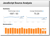




Reference Architecture in Action
Decision Framework
Usage Guide
(Service Directory)
Developer Guides
Micro - Methodology
Reference Implementation & Sample Code
Execution (Runtime) Services and Frameworks
Developer Guides
Architect
UI Developer
Development Accelerators:
Application Blueprint
Automated Dev workstation provisioning
Scaffolds and live templates
Reusable UX/UI components
Automated build, test, and optimize tasks
CD Environments
Application Code and Artifacts
Automated Environment
Provisioning Script
CI
Load
Ba
l
ance
r
Web Server
Web API
Analyze,
Test
mocha
Automated Application Deployment Script
Web Server
Web API
Deploy
Build
Reference Architecture
Application

Slide 24











Build - Assets
Scaffolding
Task Automation
Developer productivity is at the heart of AOWP
Scaffolding for rapid application structure: so developers can focus on application logic.
Preconfigured Environments: so developers can focus on code instead of setup and troubleshooting local machines.
Task Automation: so developers can focus on value-add work, rather than the tasks that take time but can easily be automated or add little visible value.
Development Accelerators: reusable code modules and guides that enable developers to focus on what’s unique about an application, not reinventing the wheel.
Model
analyze
build
Route
test
serve
View
Logger
Widgets
other common tasks
UI Developer
Pre-configured Environments
Development Accelerators
Developer Guides
Integration Docs
Pre-Built Components
Local Package Repository

Slide 25



Build - Technology
Two distinct framework ecosystems supported: Backbone/Marionette and Angular.js, each with a complete reference architecture
Our component-based reference architectures contain pre-integrated best-of-breed open source components selected through rigorous analysis:
Reference application builds
Developer productivity analysis
Ease of integration with other components
Performance
Real project experience

Slide 26
Deliver - Methodology
Utilize state of the industry automation and continuous integration / continuous delivery to reduce delivery timeline and cost
Marry quality-first engineering principles and lean DevOps with Accenture’s battle-proven agile delivery methods to produce high quality
Focus on working hand-in-hand with UX and creative teams in a unified agile process using prototype-driven development
Interaction Design
UX Sprint
Visual Design
Development
Dev Sprint
QA Cycles

Slide 27
Deliver – Everyone is Agile
Creative
Front End Dev
Back End Dev
QA
User Stories
NOT a traditional agency model where creative takes up 70% of the time and development and QA are an afterthought
Fully integrated agile processes across UX, architecture, development, functional and QA: leveraging Accenture’s integrated capabilities or working with a partner of your choosing
Client/API Development
QA
User Stories
UX / Creative
Dev Ops
Exec Arch
App Arch

Slide 28
DevOps - Technology
Modern Web Architecture requires a journey toward the next generation of agile development methods, DevOps capabilities, and quality-first engineering principles
Jenkins begins automated build & deploy process
mocha
Once code review is approved, git is used to push the code update to development branch
Grunt provides Automated task scripting
Grunt runs automated mocha behavior with chai assertions and unit tests via phantomjs & casperjs
JS Hint runs code quality tests and Plato runs code analyses
Developer cuts feature branch, writes tests, writes code, and submits for review
Check-in merged to Phabricator for pre-commit review by senior developers
Code artifacts, including applications are stored/retrieved in NPM and Bower
Passes Automated QA
Feedback is passed to developers
Code is packaged & readied for deploy by Grunt
QA Testers test on multiple devices
Code is deployed to environments by Jenkins via Docker

Slide 29

DevOps - Methodology
JavaScript is a first-class citizen, not an afterthought!
Test Driven Development increases understanding of the objectives for code before it’s written
Continuous Everything: code analyses, full automated unit/functional regression, and optimization with each development branch push
Pre-commit code review ensures good code before that code is inflicted upon others

Slide 30

Deliver - Test Automation
A single node.js-based testing toolset for all levels of testing and all testing functions
Test all browsers and common devices, run via Grunt locally or on CI
The same test suite works with client side JS and node.js on the server
Tool | Test Function
Mocha | Unit, API, Functional
Chai | Test Assertions
Sinon | Mock Data
CasperJS
PhantomJS
WebdriverJS
Chrome
Firefox
Safari
Internet Explorer
Appium (iOS, Android)
+
Selenium
mocha

Slide 31

Deliver – Test Driven Development
Write Code to Pass Test
Pass Static Analysis
Pass Code Review
Write Failing Test
AOWP development teams use a Test Driven Development methodology:
Write failing tests.
Write code to pass failing tests.
Submit for code review.
Local testing tools ensure constant feedback for developers:
Grunt can run full regressions with a single command
Karma helps run tests related to the current working code after changes are made
test
mocha

Slide 32




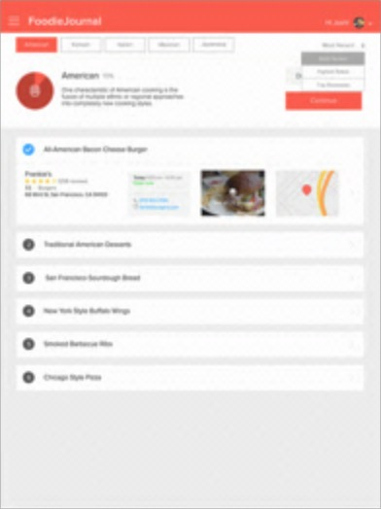


AOWP Academy
The AOWP Academy is an immersive training program that combines online interactive courses, webinars and a comprehensive application development project.
The academy uses all of AOWP’s technologies as well as the DevOps processes, architectures, and many accelerators.
Participants spend much of the course working as an agile team to deliver a real application
Participants are paired with code reviewers and coaches that ‘grade’ their performance in the course using their outputted code: developers who graduate have successfully delivered high quality code and are ready to meaningfully contribute to real projects.

Slide 33



More Information
LEADERSHIP
RAJEEV KAUL
AOWP NA Lead
MATT LANCASTER
AOWP Global Lead
OSCAR RENALIAS
AOWP EALA Lead
MORE INFORMATION
Web: http://aowp.accenture.com
Wiki: AOWP Wiki
Yammer: AOWP
Training: AOWP Academy
CONTACT
BD/SME Support Request: ATA Front Door
Email: AOWP.Support@accenture.com

Slide 34
Selected CREDENTIALS

Slide 35
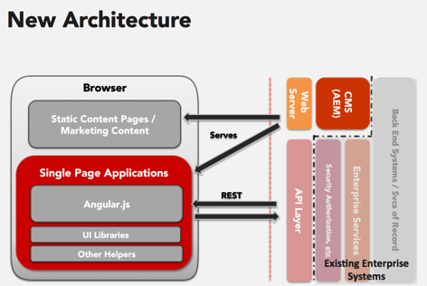
Telecom Site Re-Architecture & Re-Platform
Location: North America (USA)
OU: Communications, Media, and Technology
Success: Complete re-architecture and re-platform of top tier consumer telecommunications ecommerce and marketing sites
Re-platform, re-architect, and modernize top brand telecommunications Web properties.
Create an architecture capable of meeting ambitious user experience and performance goals in under 3 months.
Create a DevOps and development process capable of sustaining 200+ developers on Client/API technologies.
Heavily leverage AOWP assets to accelerate architecture; blend with API and CMS requirements.
Create DevOps infrastructure and capability from AOWP assets; deploy to the cloud and train development resources quickly.
Heavily leverage reusable components and
Architected new site in record time; put together solutions for CMS integration, custom scaffolding, and much more.
Created DevOps process and trained over 100 resources in 2 months to use new tools and processes. Reached maturity quickly.
Continuously improved to reduce waste in overall process; reduced headcount while improving velocity.

Slide 36








Telecom Site Re-Architecture & Re-Platform
technology stack
UI, UI Development
AngularJS, Bluebird
Yeoman, Bower
To support the objectives, the following areas were analyzed and we have provided solution options and recommendations for each:
Restful web services APIs were created inside the Apigee platform
The UI was developed using AngularJS, which also consumed APIs from Apigee and content from AEM
Adobe Experience Manager delivered the content for all marketing pages and any content-configurable pages
An integrated JavaScript testing suite of Mocha, Chai, and Sinon was used through Grunt, Protractor, and Karma
Fully functional DevOps with analysis, testing, and deployment was created; utilizing Jenkins and Grunt along with the testing tools above and analysis tools like jsHint, jscs, and Plato
Web API
Apigee
CMS
Adobe Experience Manager
Version Control
Atlassian Stash
Testing / DevOps
Jenkins, Grunt
Mocha, Chai, Sinon
Karma, Protractor
mocha
Notes:
Engagement Contacts:
Murali Rao (murali.rao), Sachin Patil, Mohammad Anwer, Dhanashree Dalal

Slide 37

Cross-Channel Digital Convergence
Location: North America (USA)
OU: Financial Services (FS) NA
Success: Modern web application platform for online banking
In order to deliver a brand-consistent, high quality user experience, the Client engaged Accenture to help define a converged digital platform targeting desktop, tablet, and mobile endpoints.
Initially, the Client had separate platforms that were unable to converge without additional enhancement/refinement of several technology architecture components.
The Accenture team performed the following activities:
Review architecture design patterns
Identify and explore solution paths
Prototype various solutions
Identify ideal components for enhancement
Review current toolset and recommend new tools as appropriate to improve productivity, code quality, and integration
Delivered Enhancements and recommendations report, identifying current and future state architecture components
Delivered an updated developer cookbook with new design patterns
Delivered reference application reflecting the future state architecture provided in the recommendations report
Notes:
Engagement Contacts:
Sven G. Loberg (sven.g.loberg), Dhananjay Goswami (dhananjay.goswami)

Slide 38















Cross-Channel Digital Convergence
technology stack
To support the objectives, the following areas were analyzed and we have provided solution options and recommendations for each:
Dependency / Package Management
Require.js, Bower
New patterns for cross-channel architecture
Page-flow management & sequence protection
Client-side Templates
Handlebars
Runtime templates
Third-party integration
Native Shell
Phonegap
Web accessibility
Caching and data storage
Client-side MVC
Backbone, Marionette
Search engine optimization
User interface technology selection
UI Libraries
jQuery, Underscore
Content management & personalization
Responsive web design
Build
Maven, Grunt
Notes:
Engagement Contacts:
Sven G. Loberg (sven.g.loberg), Dhananjay Goswami (dhananjay.goswami)

Slide 39
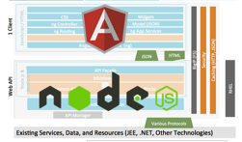
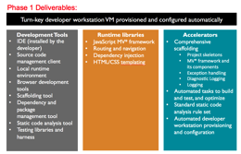
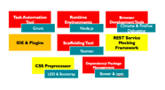
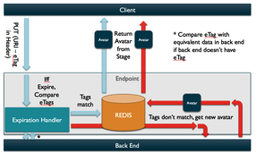
User Interface Reference Architecture
Location: North America (USA)
OU: Communications, Media, and Technology
Success: User Interface Reference Architecture (UIRA) for major entertainment and travel company’s future UI applications.
Create a modular, high performance, and fully capable reference architecture using the latest technology
Produce capable architecture ‘building blocks’ capable of being used by project teams within a few weeks
Prove technologies are enterprise-ready, higher performing than incumbent tech, and able to be adopted by client delivery teams
Create high quality, fully documented reference architecture building blocks on GitHub
Demo and evangelize components with delivery groups; train resources, help architect applications
Deliver building blocks and components consistently after technologies are proven out
All technologies proven; received go-ahead after high performance demo app created.
Generators, scaffolds, and several other key foundational building blocks created for UI and Web API
Successfully began first implementation projects using new UI RA after only 4 months

Slide 40





User Interface Reference Architecture
technology stack
UI, UI Development, Web Server
AngularJS, Bluebird
Yeoman, Bower
To support the objectives, the following areas were analyzed and we have provided solution options and recommendations for each:
NodeJS – All of the server side development was done using Node.JS
Restful APIs were written with Restify using the promises pattern via Bluebird
The UI was developed using AngularJS, served by Express, which also consumed the web services written in NodeJS
Redis was used to ‘stash’ API responses, which combined with node.js services for extremely high performance and concurrency
An integrated JavaScript testing suite of Mocha, Chai, and Sinon was used through Grunt, Protractor, and Karma
Fully functional DevOps with analysis, testing, and deployment was created; utilizing Jenkins and Grunt along with the testing tools above and analysis tools like jsHint, jscs, and Plato
Web API
NodeJS, Bluebird
Restify
API Caching
Redis
Version Control
Github
Testing / DevOps
Jenkins, Grunt
Mocha, Chai, Sinon
Karma, Protractor
mocha
Notes:
Engagement Contacts:
Murali Rao (murali.rao), Sachin Patil, Mohammad Anwer, Dhanashree Dalal

Slide 41

Case Management Software
Location: Nordics
OU: Health & Public Service
Success: Building a custom case management solution for major government agency that fit their use case and allowed maximum flexibility and usability.
Create an application able to serve Desktop thick client capabilities (document management/editing, seamless screen transitions, etc.) with a Web application
Build a system capable of working and enhancing client’s business processes such that case load is reduced and users become more productive
Design end-to-end custom system using lightweight architecture principles
Create UI that provides end users with a desktop-like user experience, on the browser, by working closely with Fjord UX team to match aspirational service designs
Outstanding user experience in an application that the client is already proudly showing to other government departments
Scalable API-based lightweight architecture

Slide 42

Case Management Software
technology stack
UI, UI Development
AngularJS
Yeoman, Bower
To support the objectives, the following areas were analyzed and we have provided solution options and recommendations for each:
NodeJS – All of the server side development was done using Node.JS
Restful APIs were written in Java using a lightweight approach, and utilized
The UI was developed using AngularJS
Redis was used to ‘stash’ API responses, which combined with node.js services for extremely high performance and concurrency
An integrated JavaScript testing suite with Jasmine, Grunt, Protractor, and Karma
Fully functional DevOps with analysis, testing, and deployment was created; utilizing Jenkins and Grunt along with the testing tools above and analysis tools like jsHint, jscs, and Plato
Web API
Java
API Caching
?
Version Control
Atlassian Stash
Testing / DevOps
Jenkins, Grunt
Jasmine
Karma, Protractor
Notes:
Engagement Contacts:
Murali Rao (murali.rao), Sachin Patil, Mohammad Anwer, Dhanashree Dalal

Slide 43

User Experience and UI Architecture Strategic Program
Location: North America (USA)
OU: Financial Services
Success: Develop new UI/UX capability area for client’s wholesale bank in order to improve application development, user experience, and speed to market
Client wanted to move away from rigid, limiting technology and process that was impeding innovation and growth
User experience was often an afterthought in most applications, and design (when it was done) tended to be done by business analysts
Development was non-agile and used a very rigid set of tools and processes: considerations like test coverage and automation were ignored
Develop a program by which creative and innovative technology capabilities were brought to the forefront of the application development process
Introduce new UI technologies, automation and DevOps to improve capability, quality, and speed
Choose a major application in which to enshrine the new approach, develop it, and bring it to production
Despite across-the-board funding cuts affecting some goals, program was universally considered a success
Reference application developed during the program became extremely popular for increased usability, more functionality was included than originally expected
Bank processes slowly modified to include new program’s processes, enabling benefits across the board

Slide 44
ECB

Slide 45

Ashoka Data Platform
Location: APAC (India)
OU: Products
Success: Launched a modern Web application backed by RESTful APIs
Their mission is to collect and display the data regarding the improvements made by the government
The results of Ashoka questionnaires needed to be displayed as a data survey portal
The questionnaires needed to be deployed on the Heroku platform
A full-stack JavaScript architecture consisting of AngularJS, NodeJS, ExpressJS, PostgreSQL to serve the purpose of rapid agile development and development cycles
HighchartsJS used to display data in charts for clear communication to viewers
jQuery plugin and AngularJS to improved the way data was displayed
RESTful APIs for scalability
Accenture delivered a fully responsive site with a RESTful architecture, allowing streamlined scalability
Data from questionnaires are displayed in beautiful charts and diagrams for easy understanding and clear communication
Notes:
Engagement Contacts:
Murali Rao (murali.rao), Sachin Patil, Mohammad Anwer, Dhanashree Dalal

Slide 46



Ashoka Data Platform
technology stack
Front-end
AngularJS
To support the objectives, the following areas were analyzed and we have provided solution options and recommendations for each:
Back-end
NodeJS
ExpressJS
Node-Postgres
NodeJS – All of the server side development was done using Javascript i.e. NodeJS
Restful APIs were written and consumed using ExpressJS
The front-end was developed using the MVC Framework AngularJS which also consumed the web services written in NodeJS
Node-Postgres was the driver used to connect between NodeJS and PostgresSQL Database
Postgres SQL was the existing DB with the client and added some data columns to the data model to make it compliant with the client’s requirements
The whole application was versioned and merged using Github and deployed on Heroku PaaS and using the Heroku Postgres Storage and configuring with psql command line
Database
PostgreSQL
Version Control
Github
Cloud Platform
Heroku
Notes:
Engagement Contacts:
Murali Rao (murali.rao), Sachin Patil, Mohammad Anwer, Dhanashree Dalal

Slide 47
Appendix 1: Lightweight Architecture at Accenture

Slide 48
Lightweight Architecture at Accenture - Practice
Lightweight architecture (LWA) is a strategic focus for Accenture Technology’s custom delivery practices.
LWA is divided into ‘Accenture Open Platforms’ (AOPs), which are collections of reference architectures and accelerators that enable our delivery teams to utilize a common foundation built on previous experience.
Each Open Platform comprises pre-selected, pre-integrated technology mapped to reference architecture components along with accelerators and delivery aids to ensure high quality development is done quickly.
There are three AOPs:
Accenture Open Web Platform: UI
Accenture Open Services Platform: ‘Back Ends’
Accenture Open Data Platform: Data and persistence
LWA enables each AOP with state-of-the-industry DevOps capability, platform selection, and
AOSP Logo
AODP Logo

Slide 49
Other Accenture Open Platforms
Accenture Open Services Platform
Accenture Open Data Platform
The plumbing for lightweight applications: middleware, services, business logic
Consists of three distinct reference architectures + accelerators
Reactive architecture with Scala and Akka
Web API architecture with node.js
Lightweight Java architecture for middleware and services
Like AOWP, AOSP consists of reference architecture, documentation, DevOps enablement, and project accelerators
The foundation for lightweight applications: data storage, persistence
Consists of distinct reference architectures for
Persistence & caching
Data storage with noSQL with couchbase, mongodb, couchdb, and riak
Application/execution architecture for data-intensive applications
Like AOWP, AODP consists of reference architecture, documentation, developer enablement, and project accelerators

Slide 50

Lightweight Architecture at Accenture - Capability
Expert architects in North America and Europe
Delivery capability in the US, Mexico, Slovakia, Latvia, Singapore, and India
Focused expertise in JavaScript/HTML5 UI, node.js for enterprise, reactive architectures, Scala, noSQL, deployment containers, DevOps and other technologies and capabilities.
20
30
50
40
300
10
caption
LWA Logo

Slide 51
Appendix 2: Technology

Slide 52
AOWP Technology Overview
AOWP’s technologies are selected based on several factors.
The needs for each component of the reference architecture is documented, and several candidate technologies are chosen.
In addition to the unique characteristics of each architecture component, candidate technologies are evaluated on common factors, e.g.
Performance
Developer Productivity / ease-of-use
Long term viability / roadmap
Ease of integration (does it play well with others)

Slide 53
Technologies – MV*
The Model-View-Controller pattern and similar MV* patterns have become some of the most common in structuring user interface code. JavaScript-based UI is no different.
AOWP uses two different paths: Backbone/Marionette and Angular.js in order to be flexible for clients.
Backbone.js and Marionette are among the most commonly used MV* libraries, and are designed to work well with the rest of the JavaScript ecosystem, as long as they’re wrapped in a consistent reference architecture.
Angular.js is more powerful on its own, but tends to be less flexible, more proscriptive, and follows a product road map / direction that may be incompatible with some system and client requirements.

Slide 54
Technologies – Developer Productivity
Technology Sections to be filled out by LWA Core Team
Grunt, Yeoman, Bower
Guidance:
Sections:
Explanation of need
Component
1-2 sentences of justification

Slide 55
Technology - Testing

